Slide 1




How to develop Intelligent Applications with .NET
Azure OpenAI Semantic Kernel Microsoft.Extensions.AI OpenAI .NET API library
Author: Luis Coco Enríquez

Slide 2
Agenda
Topic
What is Azure OpenAI?
AI Models
How to provision Azure OpenAI in Azure Portal
Azure.AI.OpenAI
Demos

Slide 3
Agenda
Topic
What is Microsoft Semantic Kernel?
Nuget Packages
Demos
What is Microsoft.Extensions.AI?
Demos

Slide 4
Agenda
Topic
OpenAI .NET API library
Demos
.NET Conf 2024
Demos

Slide 5



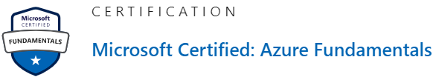
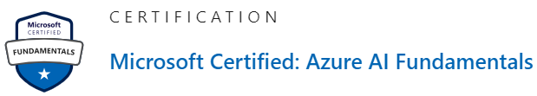


Personal profile
Senior .Net Software Engineer
AI services, Aspire .NET 9, Blazor, MAUI-Blazor Azure, AWS, Google Cloud Services
https://www.linkedin.com/in/luis-coco-enriquez-44a28a29/

Slide 6
What is Azure OpenAI?
Azure OpenAI Service provides REST API access to OpenAI's powerful LLMs language models including o1-preview, o1-mini, GPT-4o, GPT-4o mini, GPT-4 Turbo with Vision, GPT-4, GPT-3.5-Turbo, and Embeddings model series.
These models can be easily adapted to your specific task including but not limited to content generation, summarization, image understanding, semantic search, and natural language to code translation. Users can access the service through REST APIs, Python or C# SDK, or in the Azure AI Studio.
https://learn.microsoft.com/en-us/azure/ai-services/openai

Slide 7
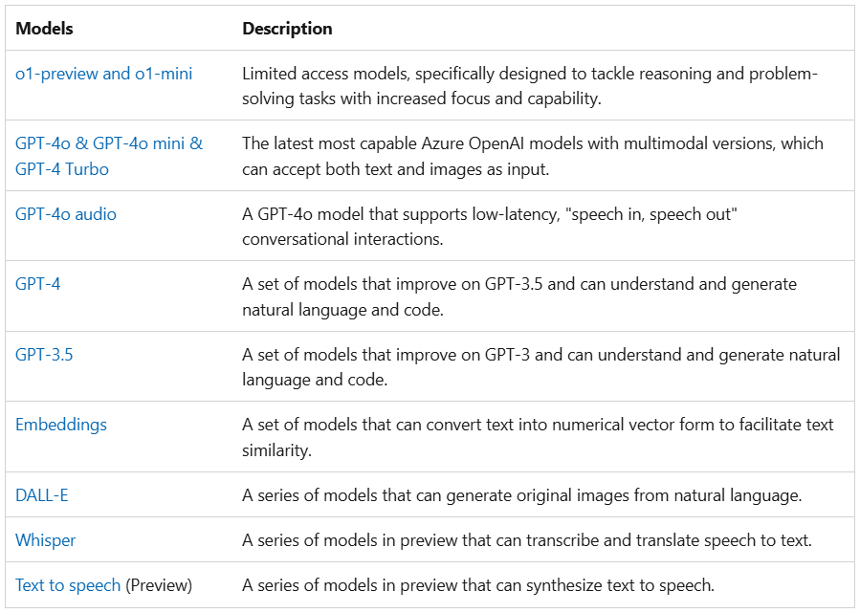
Azure OpenAI Service models
https://learn.microsoft.com/en-us/azure/ai-services/openai/concepts/models

Slide 8
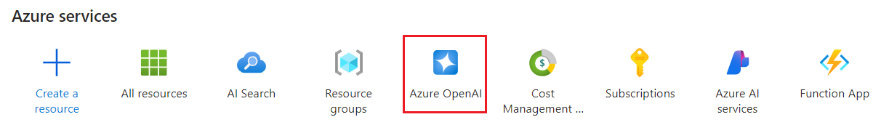
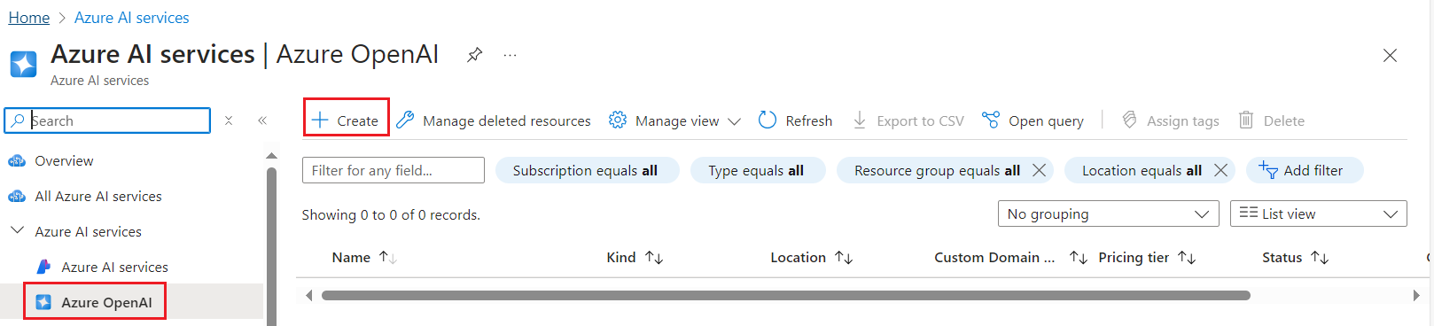
Azure OpenAI: How to provision in Azure Portal
https://github.com/luiscoco/Azure_OpenAI_How-to-deploy-GPT-4o

Slide 9
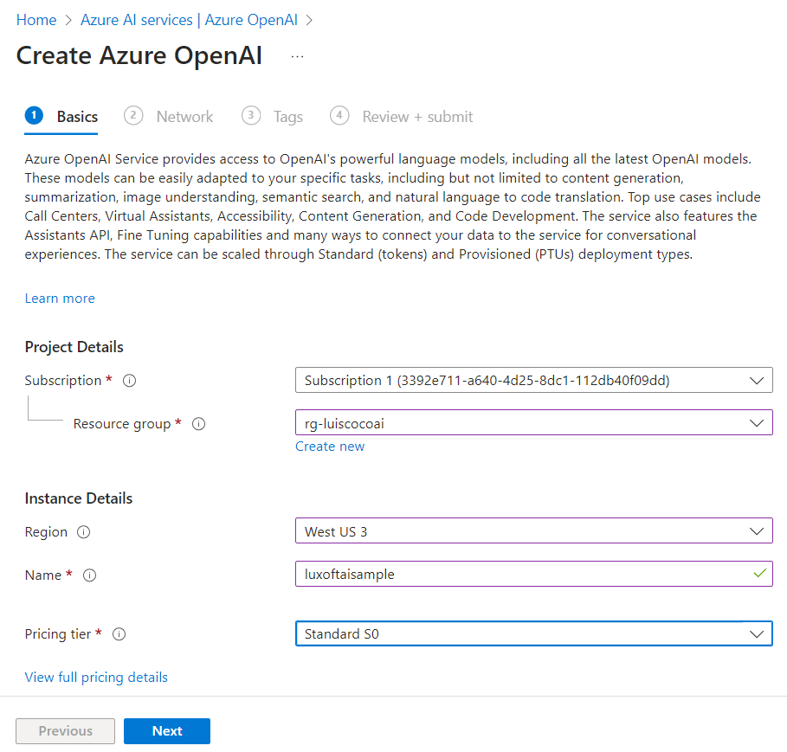
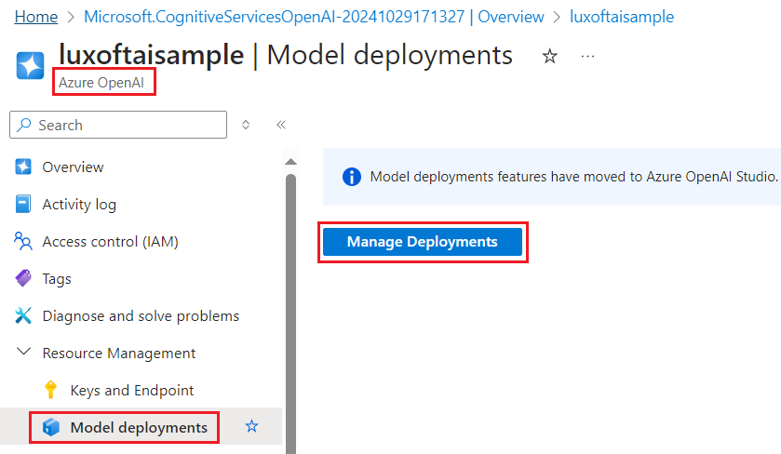
Azure OpenAI: How to provision in Azure Portal
https://github.com/luiscoco/Azure_OpenAI_How-to-deploy-GPT-4o

Slide 10
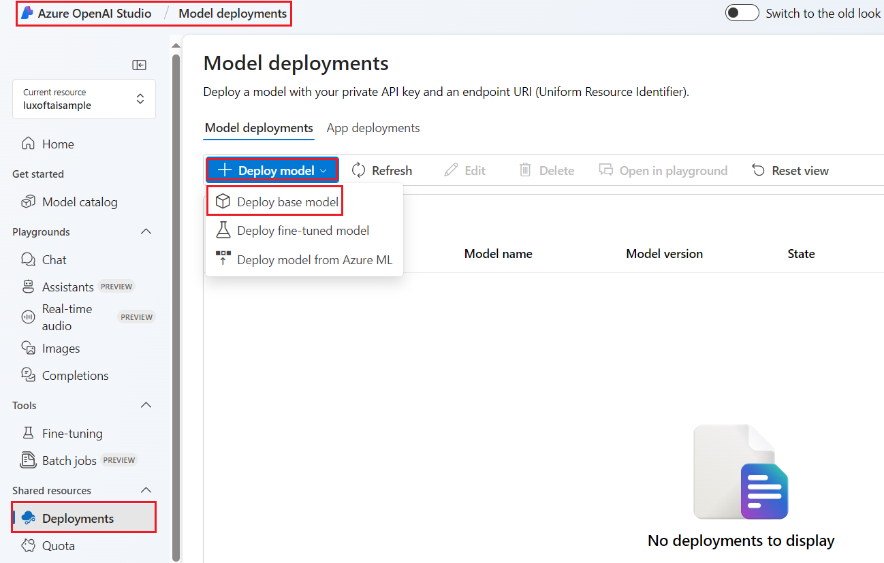
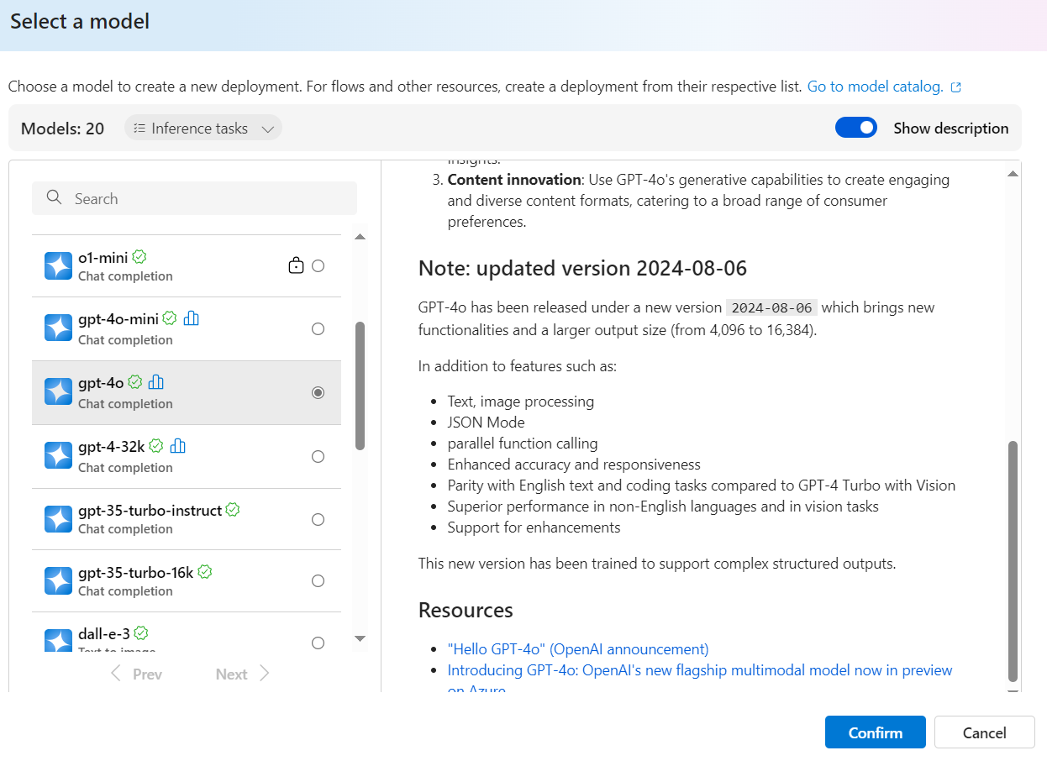
Azure OpenAI: How to provision in Azure Portal
https://github.com/luiscoco/Azure_OpenAI_How-to-deploy-GPT-4o

Slide 11
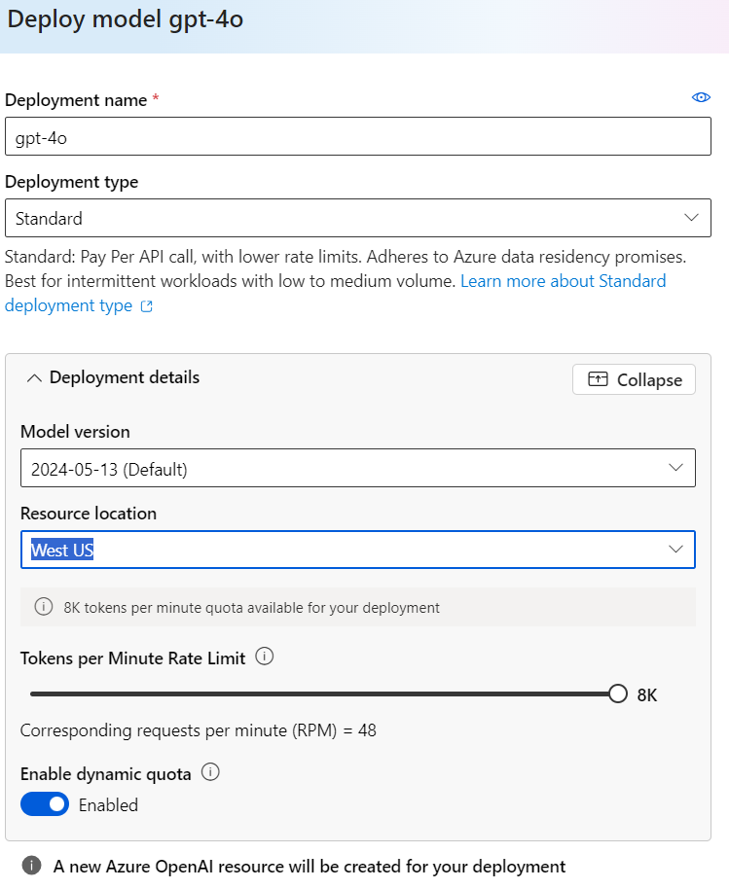
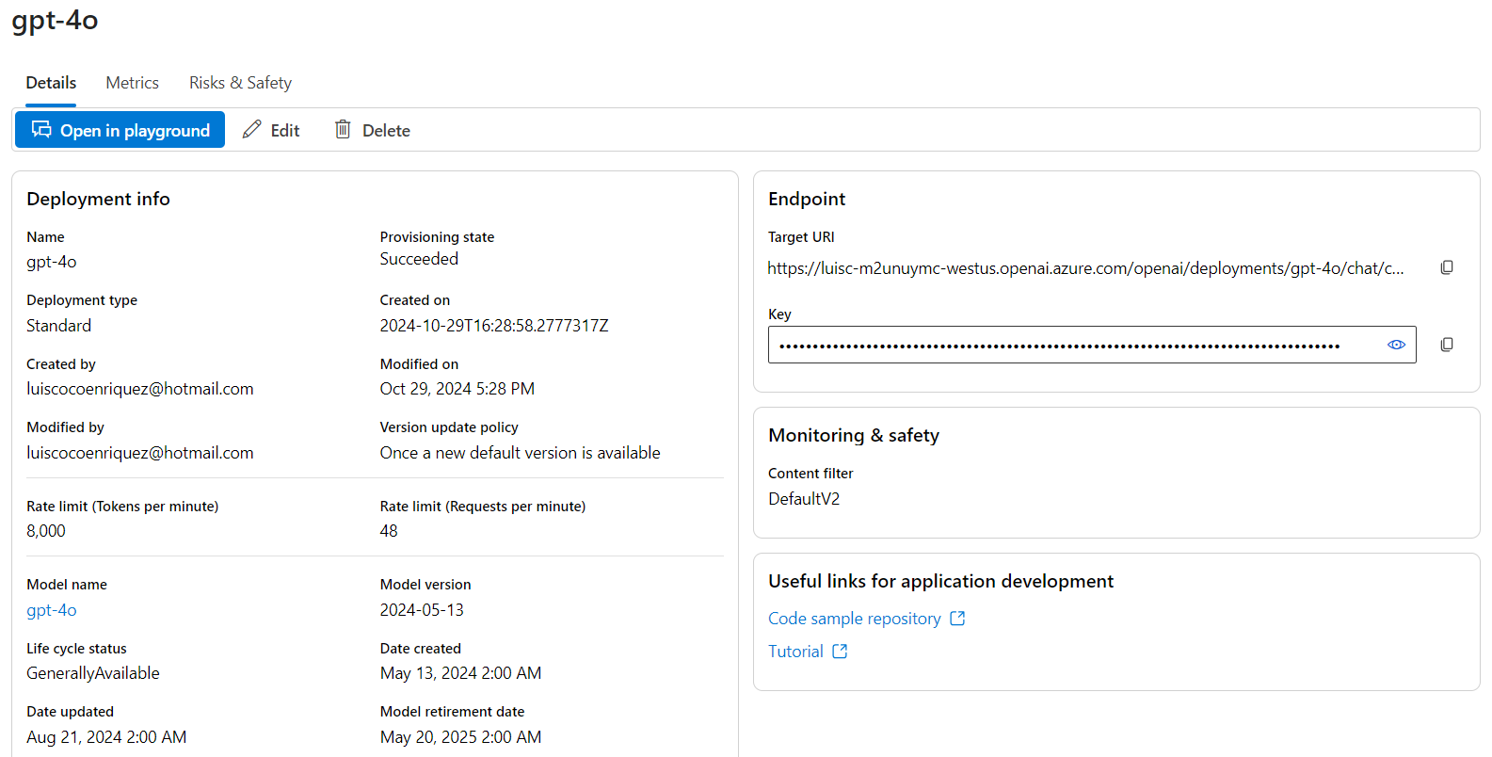
Azure OpenAI: How to provision in Azure Portal
https://github.com/luiscoco/Azure_OpenAI_How-to-deploy-GPT-4o

Slide 12
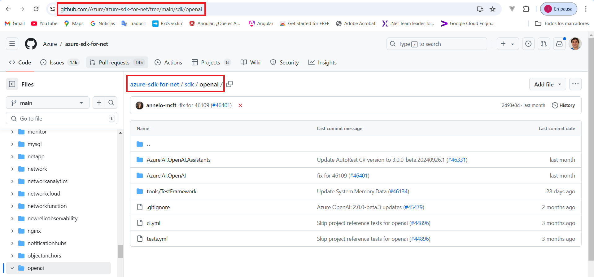
Azure OpenAI Nuget Packages
https://github.com/Azure/azure-sdk-for-net/tree/main/sdk/openai
https://www.nuget.org/packages/Azure.AI.OpenAI/2.1.0-beta.1
https://www.nuget.org/packages/Azure.AI.OpenAI.Assistants/1.0.0-beta.4
https://www.nuget.org/packages/Aspire.Azure.AI.OpenAI/9.0.0-preview.4.24511.1
https://www.nuget.org/packages/Aspire.Hosting.Azure.CognitiveServices/9.0.0-rc.1.24511.1

Slide 13
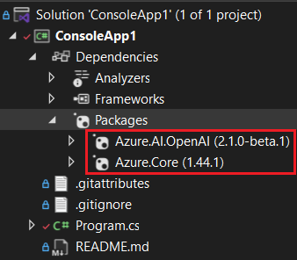
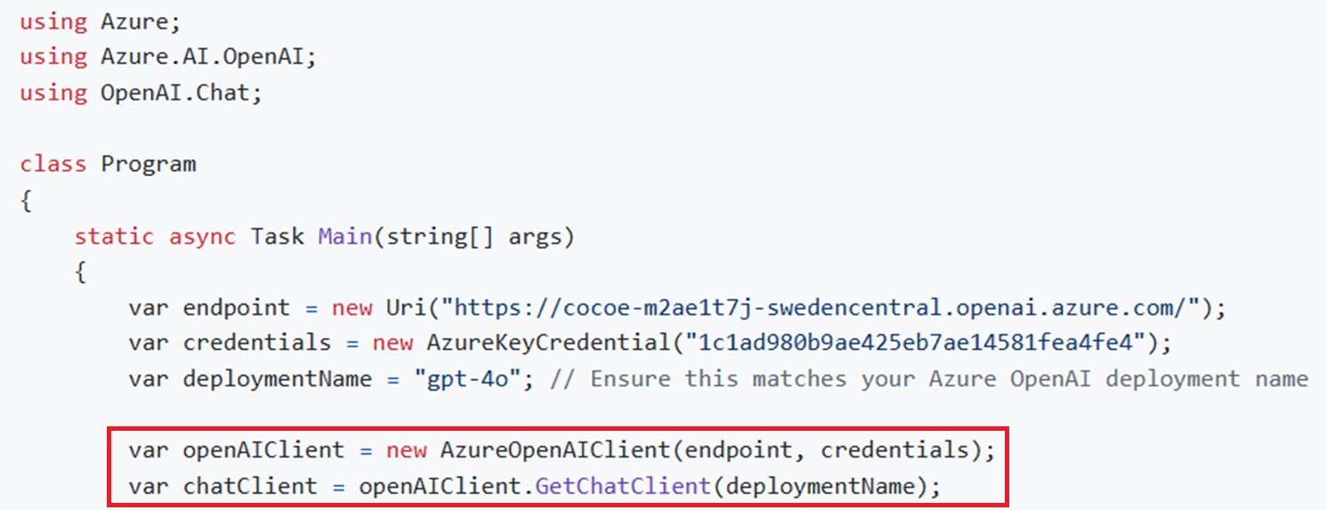
Azure OpenAI: How to provision the service with C# SDK
AzureOpenAIClient(Endpoint, Key)
GetChatClient(DeploymentName)

Slide 14
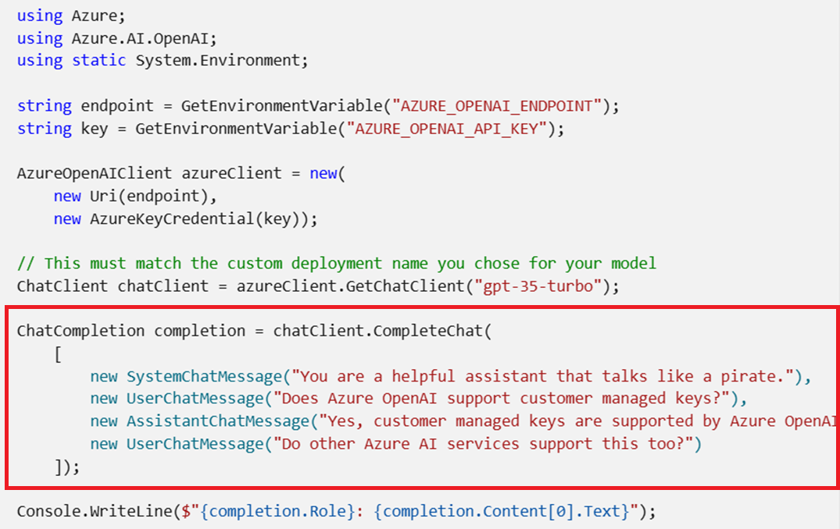
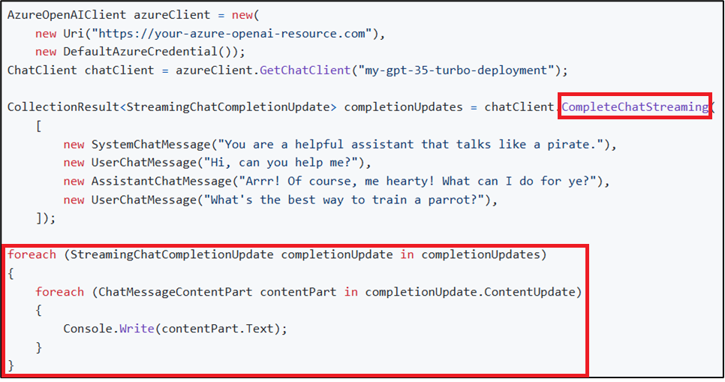
Azure OpenAI: ChatCompletion with gpt-4o model
AI Completion Service: You input some text as a prompt. The model generates the completion and attempts to match your context or pattern. Suppose you provide the prompt "As Descartes said, I think, therefore" to the API. For this prompt, Azure OpenAI returns the completion endpoint " I am" with high probability.

Slide 15
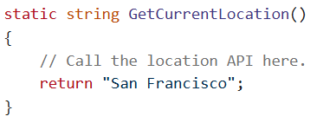
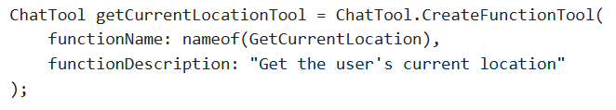
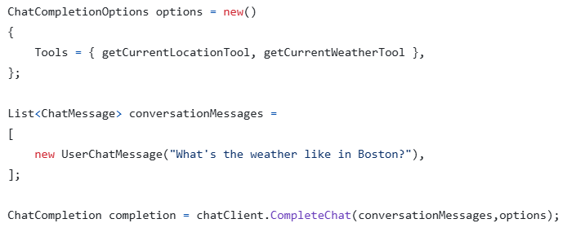
Azure OpenAI: Use Chat Tools (call Functions)
Tools extend chat completions by allowing an assistant to invoke defined functions and other capabilities in the process of fulfilling a chat completions request. To use chat tools, start by defining a function tool.
Function definition
Tool definition
Chat Options definition
https://github.com/luiscoco/Azure_OpenAI-Use_Chat_Tools-Function_Call
https://github.com/luiscoco/Azure_OpenAI-Use_Chat_Tools-Function_Call-version2

Slide 16
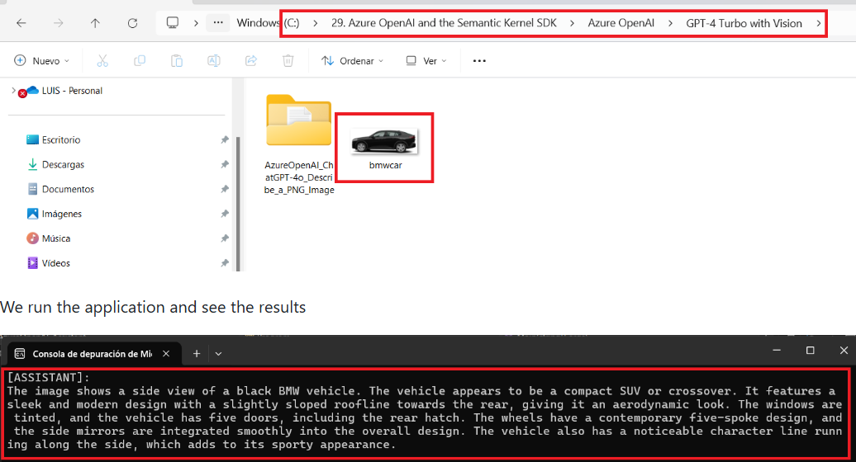
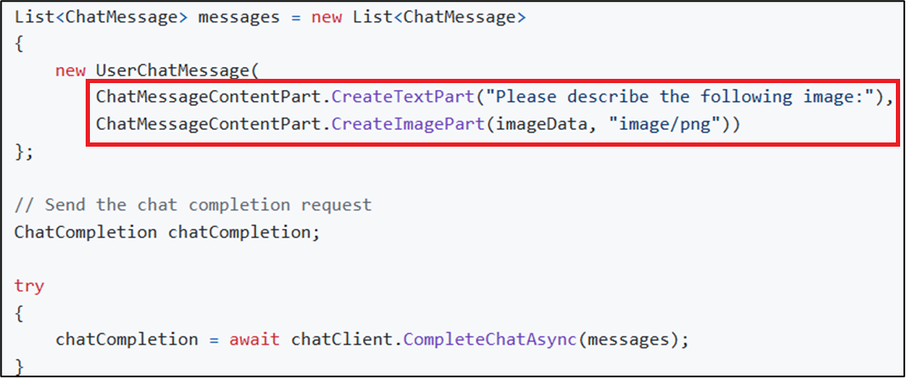
Azure OpenAI: Describe and Image with gpt-4o model
We can provide an image in the prompt when invoking the gpt-4o model with the CompleteChat function
https://github.com/luiscoco/Azure_OpenAI_GPT-4o-How_to_descritbe_an_Image

Slide 17
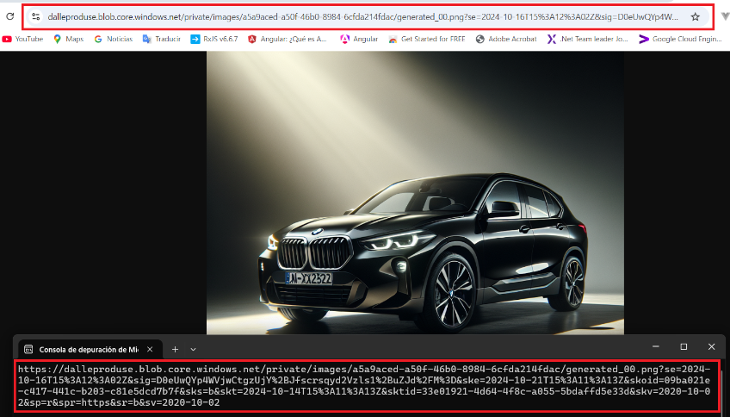
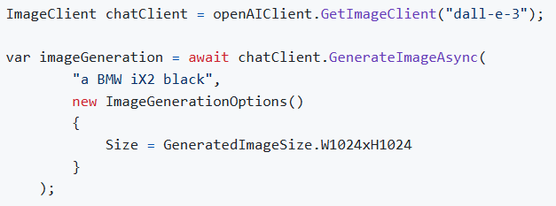
Azure OpenAI: Create an Image with DALL-E model
OpenAI's DALL-E models generate images based on user-provided text prompts
https://github.com/luiscoco/Azure_OpenAI-DALL_E_3-How_to_create_an_image

Slide 18
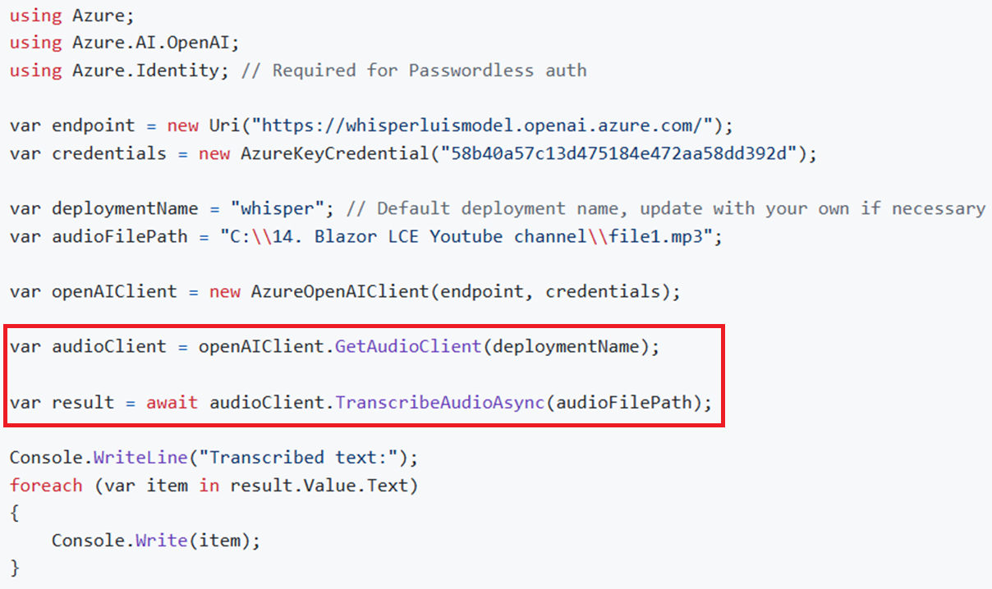
Azure OpenAI: Speech to Text with Whisper model
The Whisper model can transcribe human speech in numerous languages, and it can also translate other languages into English.
https://github.com/luiscoco/Azure_OpenAI-WhisperModel-Read_a_Text

Slide 19
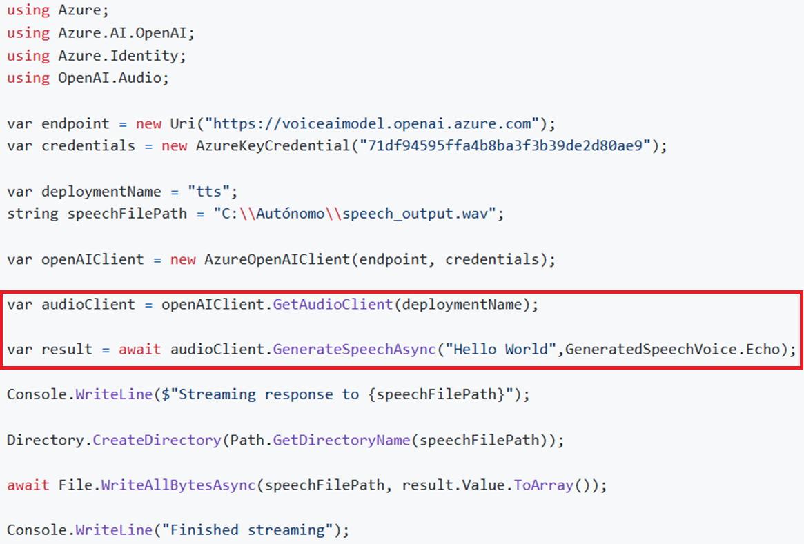
Azure OpenAI: Read a Text with tts model
https://github.com/luiscoco/Azure_OpenAI-tts-TextToSpeech

Slide 20
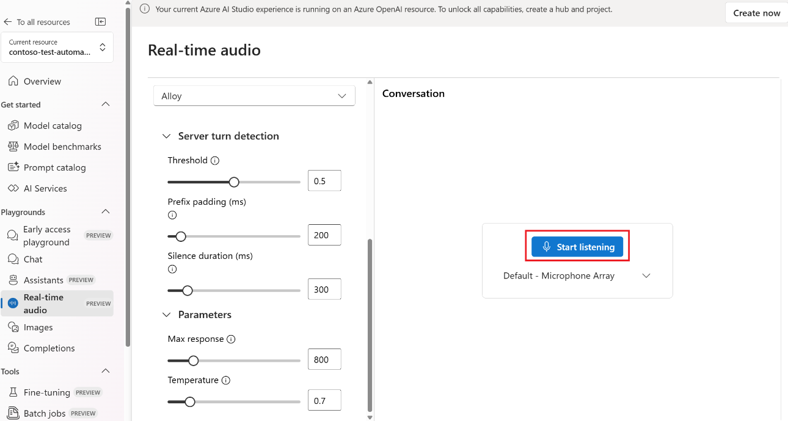
Azure OpenAI: Realtime Speech with gpt-4o-realtime-preview model
https://learn.microsoft.com/en-us/azure/ai-services/openai/realtime-audio-quickstart

Slide 21
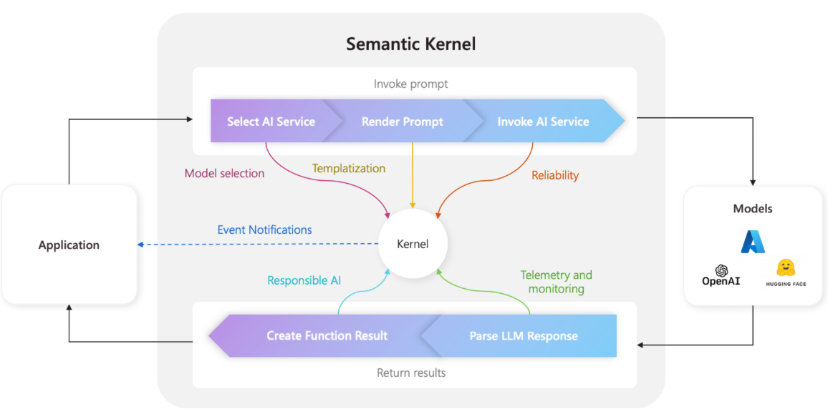
What is Microsoft Semantic Kernel?
Semantic Kernel (SK) is a lightweight SDK enabling integration of AI Large Language Models (LLMs) with conventional programming languages.
The SK extensible programming model combines natural language semantic functions, traditional code native functions, and embeddings-based memory unlocking new potential and adding value to applications with AI
https://github.com/microsoft/semantic-kernel

Slide 22
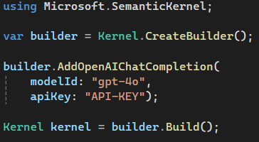
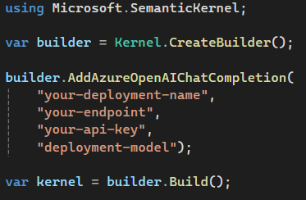
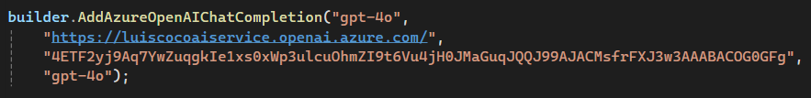
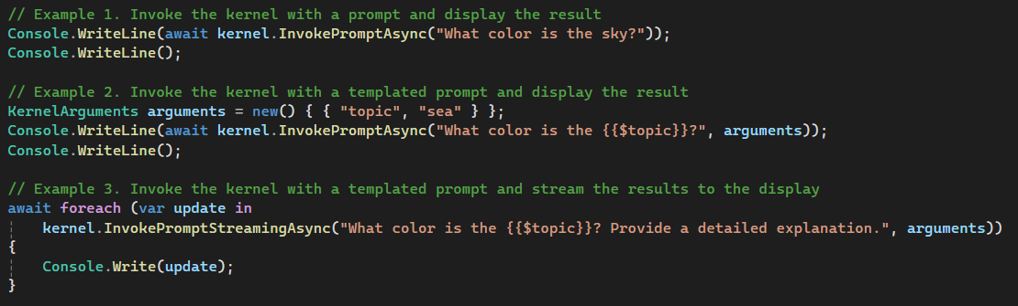
Semantic Kernel: build Kernel and invoke ChatCompletion
OpenAI service
Azure OpenAI service
https://platform.openai.com/api-keys
https://github.com/luiscoco/Curso_Aprende_Blazor-MicrosoftSemanticKernel-GetStart

Slide 23
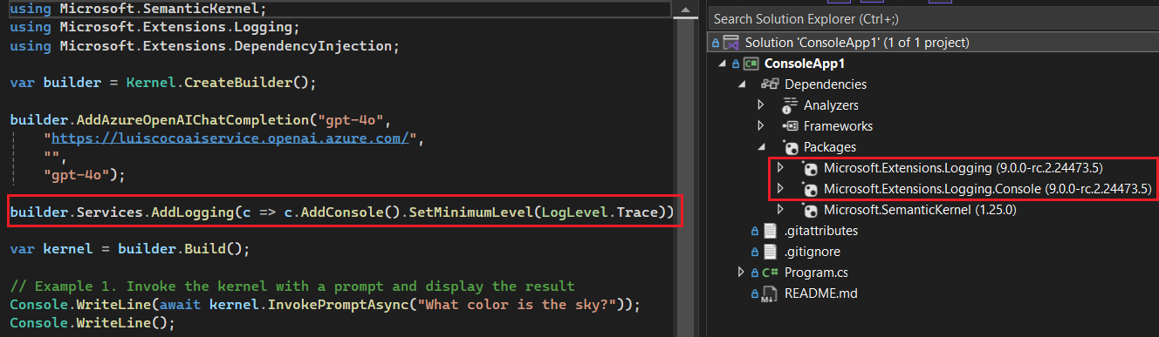
Semantic Kernel: Logging
Azure OpenAI service
https://github.com/luiscoco/Curso_Aprende_Blazor-MicrosoftSemanticKernel-Logging

Slide 24
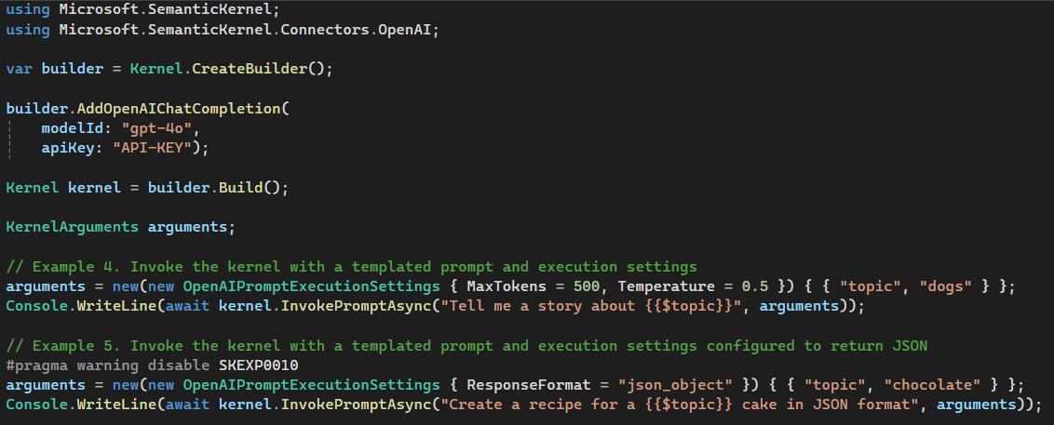
Semantic Kernel: Templated Prompt
https://github.com/luiscoco/Curso_Aprende_Blazor-MicrosoftSemanticKernel-GetStart

Slide 25
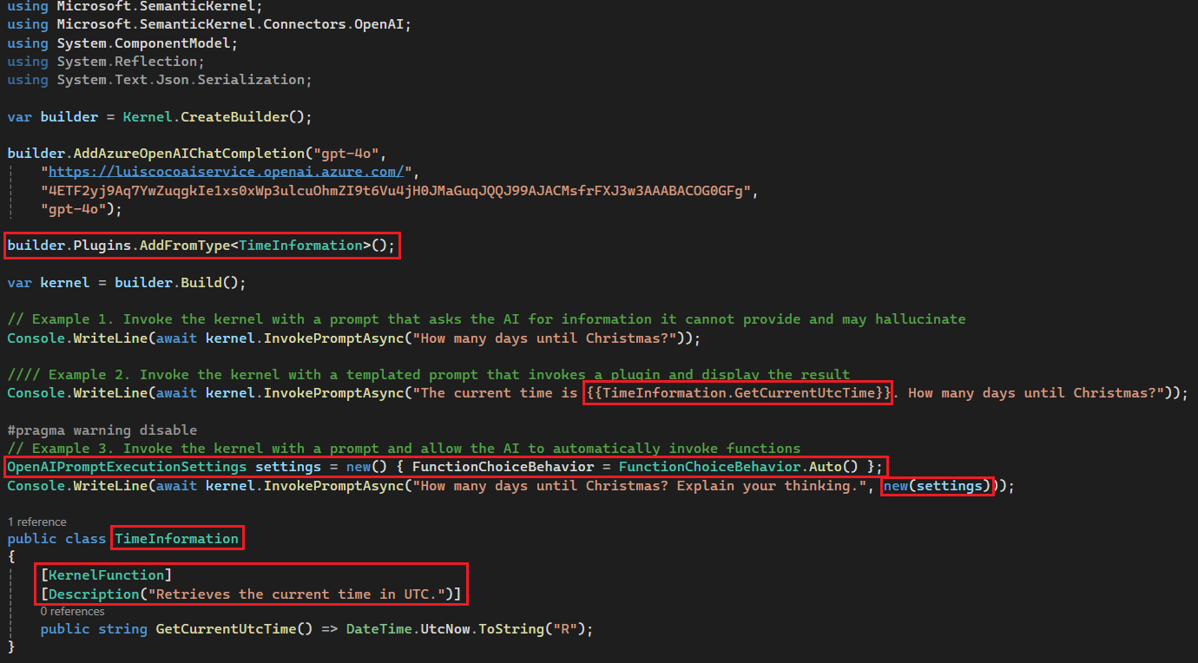
Semantic Kernel: Plugin
https://github.com/luiscoco/Curso_Aprende_Blazor-MicrosoftSemanticKernel-Plugin-Sample1

Slide 26
Semantic Kernel: Chatbot with Ollama
using Microsoft.SemanticKernel;
using System;
using System.ClientModel.Primitives;
var endpoint = new Uri("http://localhost:11434");
var modelId = "phi3:latest";
#pragma warning disable SKEXP0010
var kernelBuilder = Kernel.CreateBuilder()
.AddVolatileVectorStore()
.AddOpenAIChatCompletion(modelId: modelId, apiKey: null, endpoint: endpoint);
#pragma warning restore SKEXP0010
var kernel = kernelBuilder.Build();
const string skPrompt = @"
JamicanFoodBot can give you recommendations on Jamaican Food cuisine and recipes.
It can give explicit instructions on how to cook these dishes. It will provide you ingredients, measurements, and cook time.
{{ $history }}
User: {{ $userInput }}
JamicanFoodBot:";
var chatFunction = kernel.CreateFunctionFromPrompt(skPrompt);
var history = "";
var arguments = new KernelArguments
{
["history"] = history
};
while (true)
{
Console.Write("Tell me what kind of food you are in the mood for: ");
var userInput = Console.ReadLine();
if (userInput.Equals("quit", StringComparison.OrdinalIgnoreCase))
{
Console.WriteLine("Goodbye!");
break;
}
arguments["userInput"] = userInput;
Console.Write("JamaicanFoodBot: ");
await foreach (var chunk in kernel.InvokeStreamingAsync(chatFunction, arguments))
{
Console.Write(chunk);
history += chunk;
}
history += $"\nUser: {userInput}\n";
arguments["history"] = history;
Console.WriteLine();
Console.WriteLine("Conversation history:");
Console.WriteLine(history);
}
https://github.com/luiscoco/Curso_Aprende_Blazor-MicrosoftSemanticKernel-Chatbot_Ollama

Slide 27
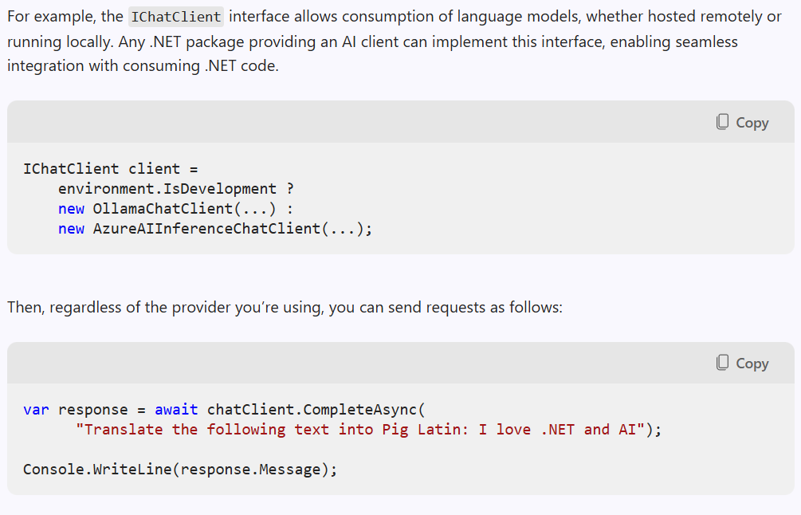
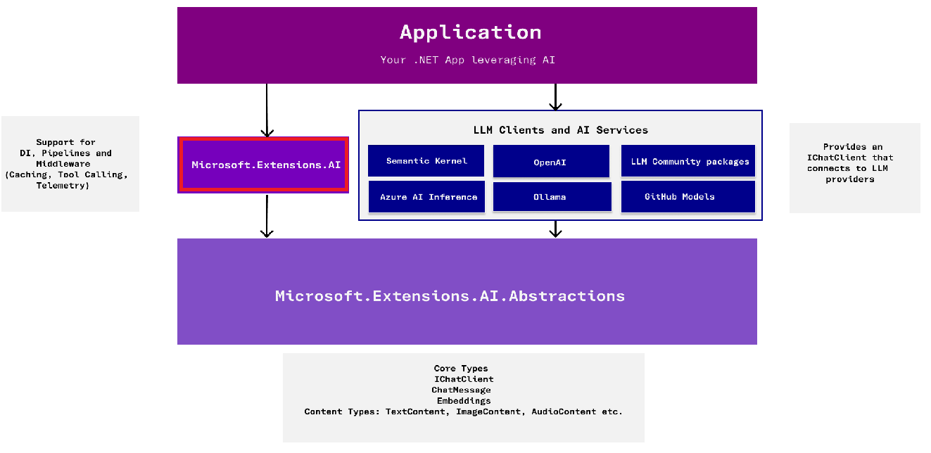
What is Microsoft.Extensions.AI?
These libraries provide a unified layer of C# common abstractions and standard middleware implementation for interacting with AI services
https://devblogs.microsoft.com/dotnet/introducing-microsoft-extensions-ai-preview

Slide 28
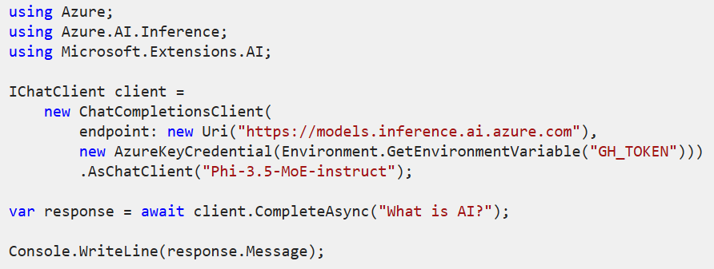
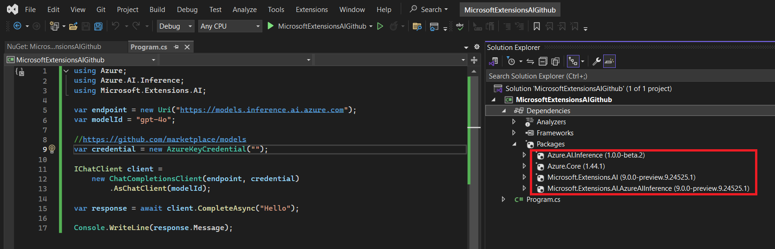
Microsoft.Extensions.AI: Azure AI Inference (Github Models)
Install the Microsoft.Extensions.AI.AzureAIInference NuGet package
https://github.com/luiscoco/microsoft-extensions-ai-github_ai_model
https://github.com/marketplace/models

Slide 29
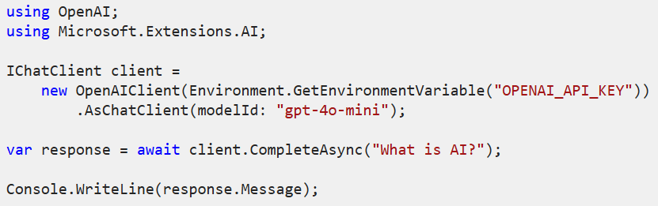
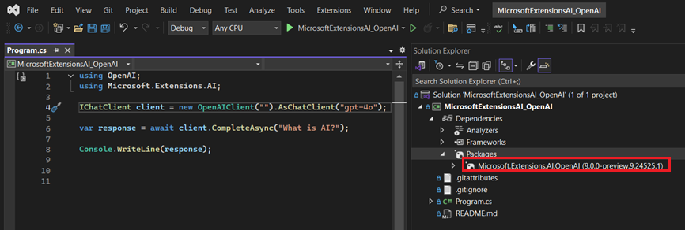
Microsoft.Extensions.AI: OpenAI
Install the Microsoft.Extensions.AI.OpenAI NuGet package
https://platform.openai.com/api-keys
https://github.com/luiscoco/microsoft-extensions-ai-OpenAI

Slide 30
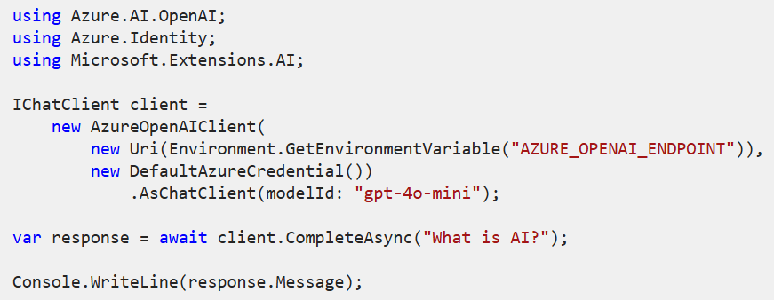
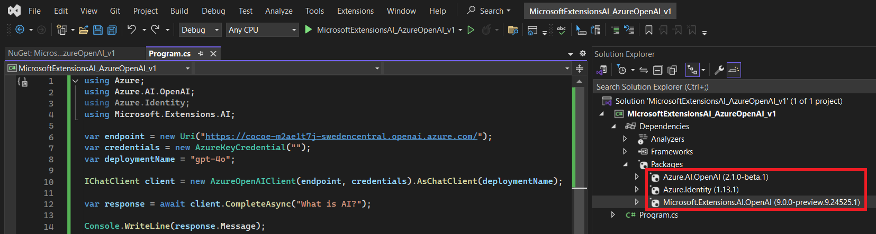
Microsoft.Extensions.AI: Azure OpenAI
Install the Microsoft.Extensions.AI.OpenAI, Azure.AI.OpenAI, and Azure.Identity NuGet packages
https://github.com/luiscoco/microsoft-extensions-ai-AzureOpenAI

Slide 31
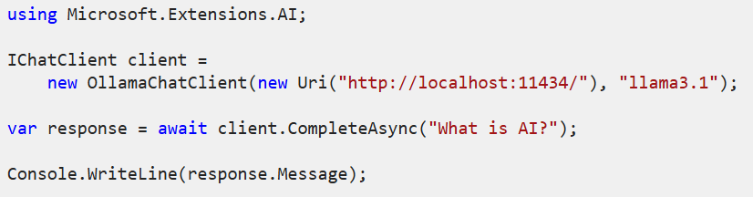
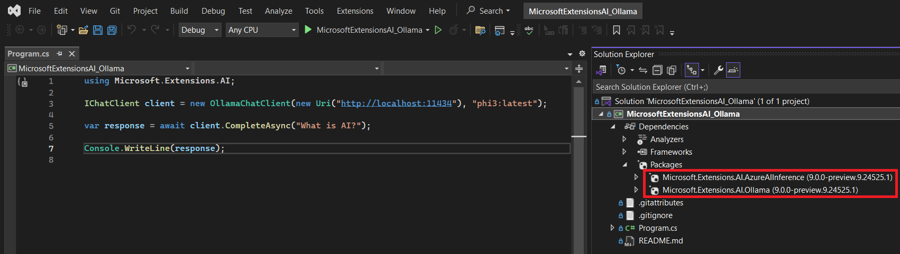
Microsoft.Extensions.AI: Ollama
Install the Microsoft.Extensions.AI.Ollama NuGet package
https://github.com/luiscoco/microsoft-extensions-ai-Ollama

Slide 32
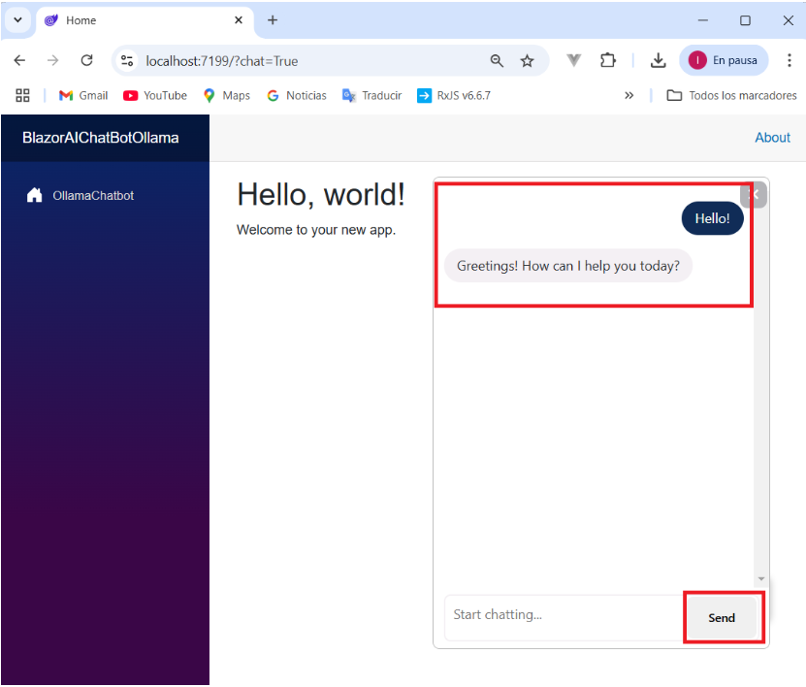
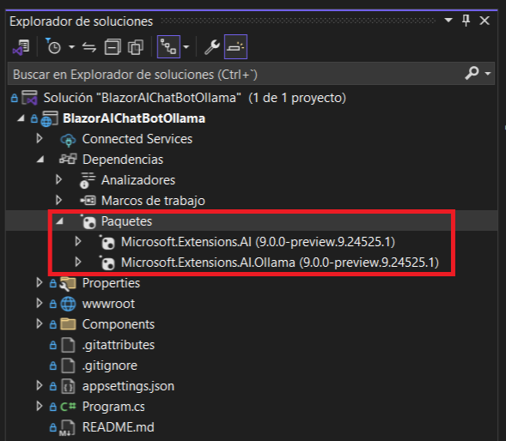
Microsoft.Extensions.AI: Blazor Web App with Ollama Chatbot
https://github.com/luiscoco/microsoft-extensions-ai-sample-BlazorAIChatBot_with_Ollama

Slide 33
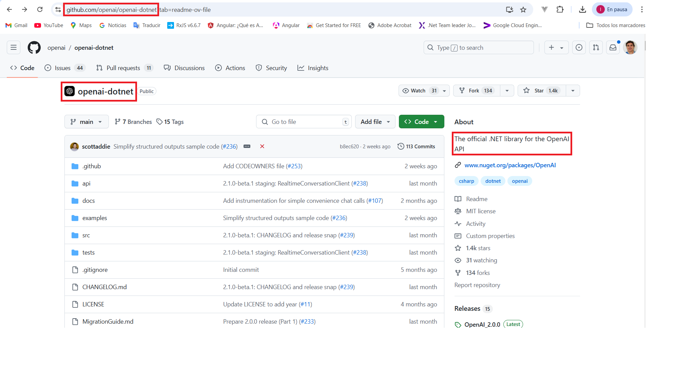
OpenAI .NET API library
The official .NET library for the OpenAI API
https://github.com/openai/openai-dotnet
https://www.nuget.org/packages/OpenAI
https://github.com/openai/openai-openapi/blob/master/openapi.yaml

Slide 34
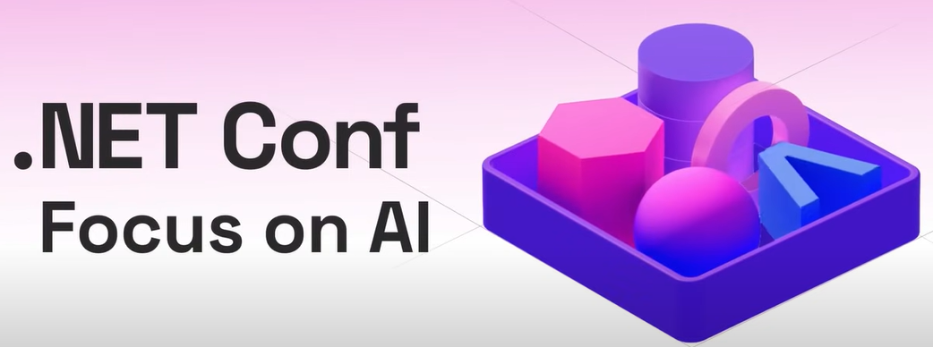
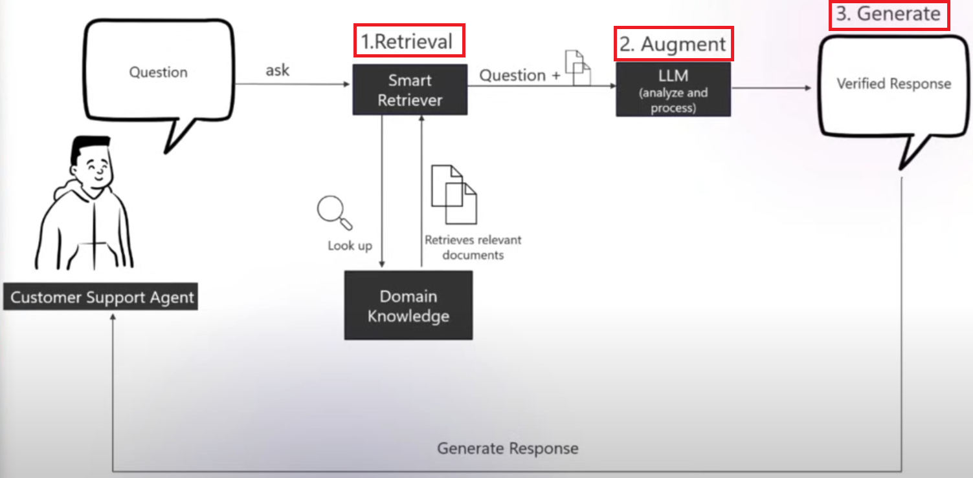
RAG (Retrieval Augmented Generation)
RAG is an AI technique that combines retrieval-based and generative models to improve information relevance and accuracy in responses. In RAG, a retrieval model first searches a large database or set of documents to find relevant information based on the user's query. Then, a generative model (like GPT) uses the retrieved information to produce a coherent, context-aware response. This approach helps the AI provide responses that are both accurate and grounded in relevant data sources, making it particularly useful for tasks requiring specific or factual information.
Efficiently Searching PDF Content with AI: Leveraging LLMs and RAG for Enhanced Retrieval
https://github.com/microsoft/AzureDataRetrievalAugmentedGenerationSamples

Slide 35
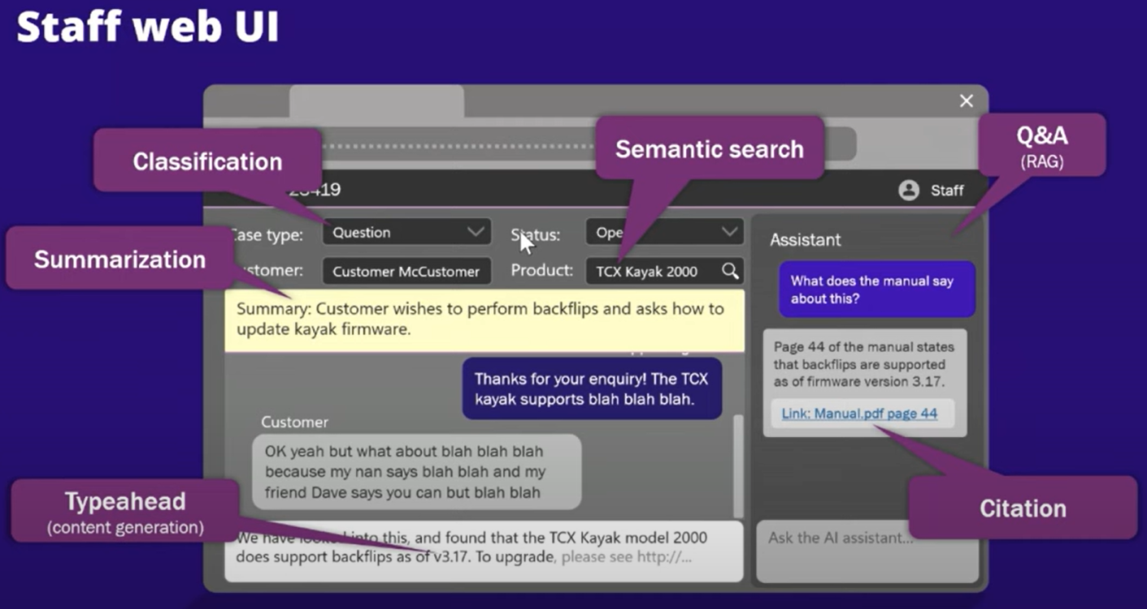
eShopsupport
Youtube video
https://github.com/dotnet/eShopSupport
https://github.com/luiscoco/Curso_Aprende_Blazor-Nivel_Intermedio-AI_eShopSupport-Assistant_Fixed-With-Azure_OpenAI
https://github.com/luiscoco/Curso_Aprende_Blazor-Nivel_Intermedio-AI_DataGenerator

